Slide 1
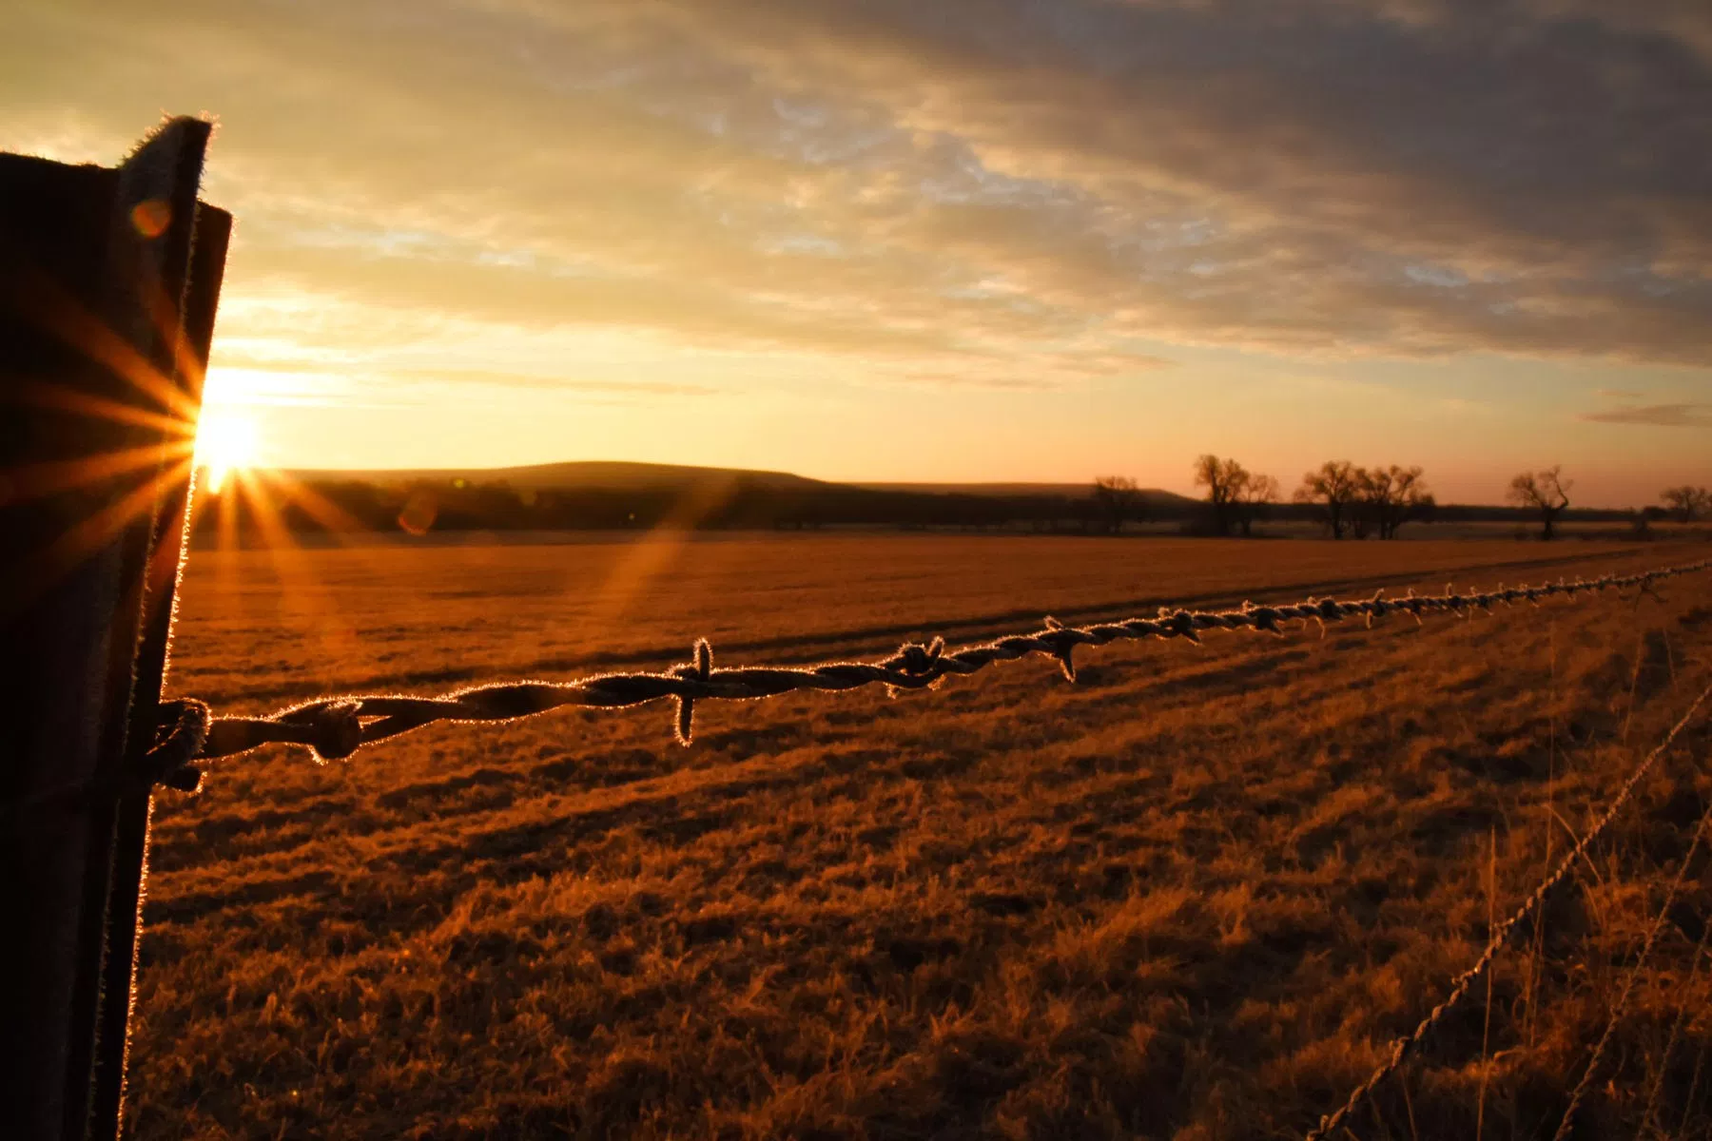
Advanced Wastewater Treatment
University of Kansas
100th Annual Water and Wastewater School
Lawrence, Kansas
August 1, 2019
Grant Weaver, PE & wastewater operator
G.Weaver@CleanWaterOps.com

Slide 2
Kansas Nutrient Reduction Strategy
total-Nitrogen total-Phosphorus
Mechanical Plants 10 mg/L 1.0 mg/L
Lagoons no increase no increase

Slide 3
Wastewater treatment for Beginning Operators
Grow bacteria that feed on soluble pollutants
Settle out the bacteria
Send clean water into the stream

Slide 4
Wastewater treatment for Advanced Operators
Grow bacteria that feed on soluble pollutants by maintaining optimal living conditions for the bacteria that treat wastewater
    BOD
    Nitrogen
    Phosphorus
    Alkalinity / pH

Slide 5
Wastewater treatment for Advanced Operators
Grow bacteria that feed on soluble pollutants by maintaining optimal living conditions for the bacteria that treat wastewater
    BOD
    Nitrogen
    Phosphorus
    Alkalinity / pH
Settle out the bacteria by managing clarifiers and excellent process control

Slide 6
Wastewater treatment for Advanced Operators
Grow bacteria that feed on soluble pollutants by maintaining optimal living conditions for the bacteria that treat wastewater
    BOD
    Nitrogen
    Phosphorus
    Alkalinity / pH
Settle out the bacteria by managing clarifiers and excellent process control
Send cleaner water into the stream

Slide 7
Wastewater treatment for Advanced Operators
Grow bacteria that feed on soluble pollutants by maintaining optimal living conditions for the bacteria that treat wastewater
    BOD
    Nitrogen
    Phosphorus
    Alkalinity / pH
Settle out the bacteria by managing clarifiers and excellent process control
Send cleaner water into the stream
Create the right conditions to maximize the controlled release of nitrogen gas

Slide 8


Slide 9

Advanced Wastewater Treatment
Process control!
Collect data
Compile, analyze, and interpret data
Intelligently apply data

Slide 10
Process Control
Set Process Control targets; e.g., Aeration ORP and DO
Monitor for the right parameters in the right places
Record data on a Daily Log
Assign someone the responsibility for DAILY analyzing and using the data
Develop relationships; e.g., Aeration ORP vs. Ammonia Removal
Periodically, review and update procedures

Slide 11
Process Control Targets
Conventional Treatment:
Aeration Basin DO / ORP
Aeration Basin MLSS / Sludge Age
Clarifier RAS, WAS, blanket depth
UV irradiance / transmittance
Nitrogen Removal:
Ammonia Removal
Aeration Basin DO / ORP (for phosphorus, too)
Aeration Basin Alkalinity / pH (for phosphorus, too)
Final effluent Ammonia
Nitrate Removal
Anoxic Zone ORP
Anoxic Zone Nitrate
Final effluent Nitrate
Phosphorus Removal:
Phosphorus Release
Fermenter ORP
Fermenter orthophosphate
Phosphorus Uptake
Aeration Basin DO / ORP and Alkalinity / pH
Final effluent orthophosphate

Slide 12
Measurement Tools

Slide 13
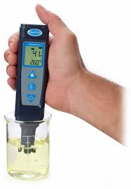
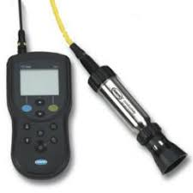
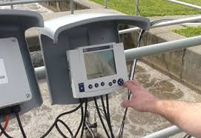
ORP or
Oxidation Reduction
Potential
Fermenter
Phosphorus Release
Aeration Basin
Ammonia Removal
Phosphorus Uptake
Anoxic Zone
Nitrate Removal

Slide 14
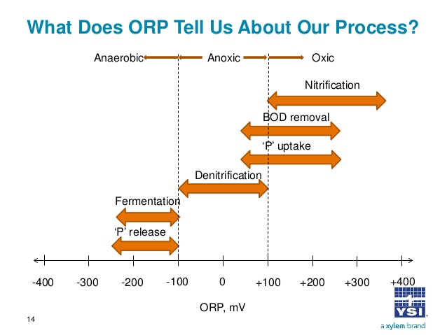

Slide 15
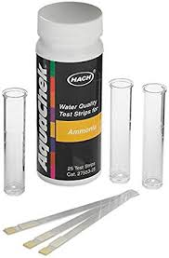
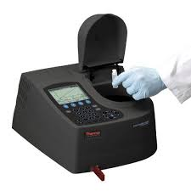
Ammonia
Aeration Basin
Profile
Final Effluent
Daily performance

Slide 16
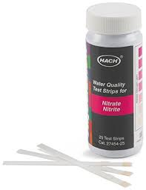
Nitrate
Anoxic Zone
Daily performance
Final Effluent
Daily performance

Slide 17
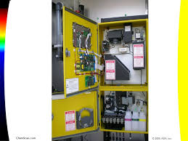
Phosphorus
Fermenter
Weekly performance
Aeration Basin
Weekly performance
Final Effluent
Daily performance

Slide 18
Field testing for phosphorus
Phosphorus limits and commercial lab results report phosphorus – both total-phosphorus and orthophosphate – as P, phosphorus.
Many machines report orthophosphate “as PO₄.”
If so, reset machine to record “as PO₄-P” or, the same thing, “as P.”
If you can’t change the readings, divide “as PO₄” results by 3 to get “as PO₄-P” or “as P” values.

Slide 19
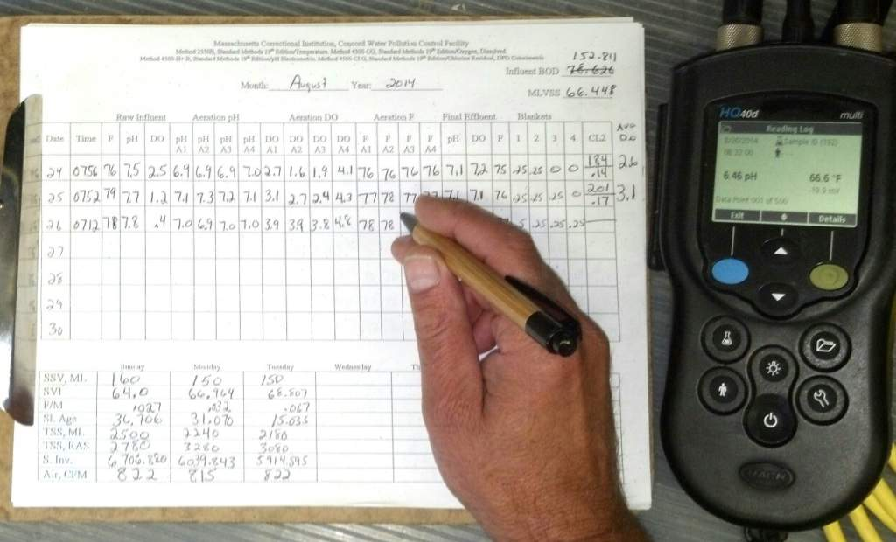
Daily Log

Slide 20

Put Process Control Data to Use
Establish targets for each test
ORP
Ammonia, Nitrate, Orthophosphate
Know what to do if readings are above or below targets
Fermenter
Aeration Basin
Anoxic Zone
Final Effluent
Refine and update targets
Seasonality
Changing Influent Characteristics

Slide 21
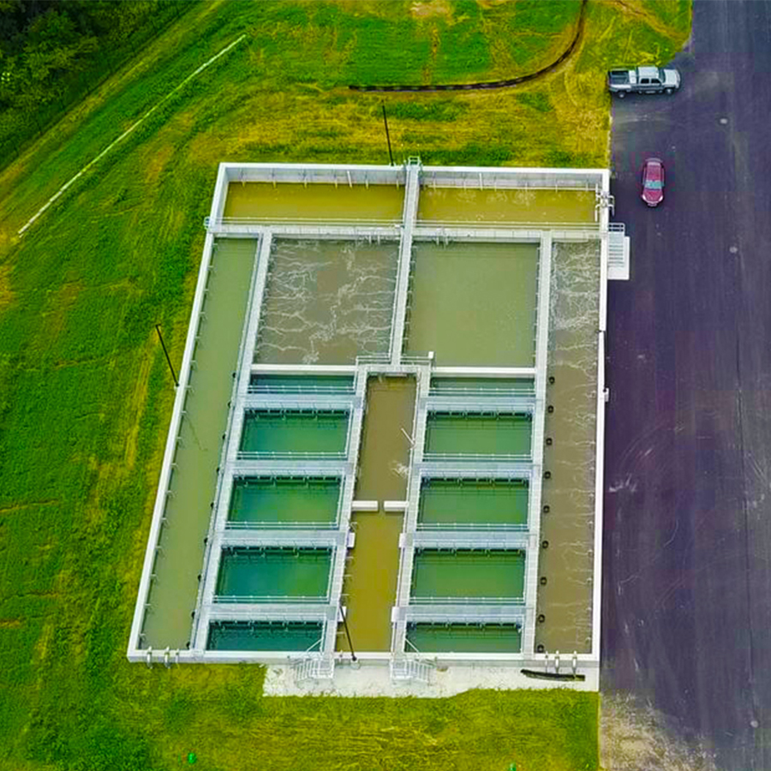
Aero-Mod

Slide 22
Aero-Mod
Aerobic Zone
Clarifier
Anoxic Zone
Fermenter / Selector
Clarifier
Aerobic Zone
Anoxic Zone

Slide 23
Aero-Mod
Anoxic Zone
Clarifier
Aerobic Zone
Fermenter / Selector
Clarifier
Anoxic Zone
Aerobic Zone

Slide 25
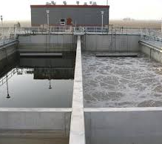
Sequencing Batch Reactor
SBR

Slide 26
Sequencing Batch Reactor (SBR)
Settle, Decant & Waste Sludge
SBR #1
SBR #2
Decant / Waste
Air ON
Sludge Storage

Slide 27
Sequencing Batch Reactor (SBR)
Ammonia (NH₄) Removal: Nitrification
SBR #1
SBR #2
NH₄
NO₃
Air ON
Idle
Sludge Storage

Slide 28
Sequencing Batch Reactor (SBR)
Nitrate (NO₃) Removal: Denitrification
SBR #1
SBR #2
NO₃
N₂
Air OFF
Idle
Sludge Storage

Slide 29
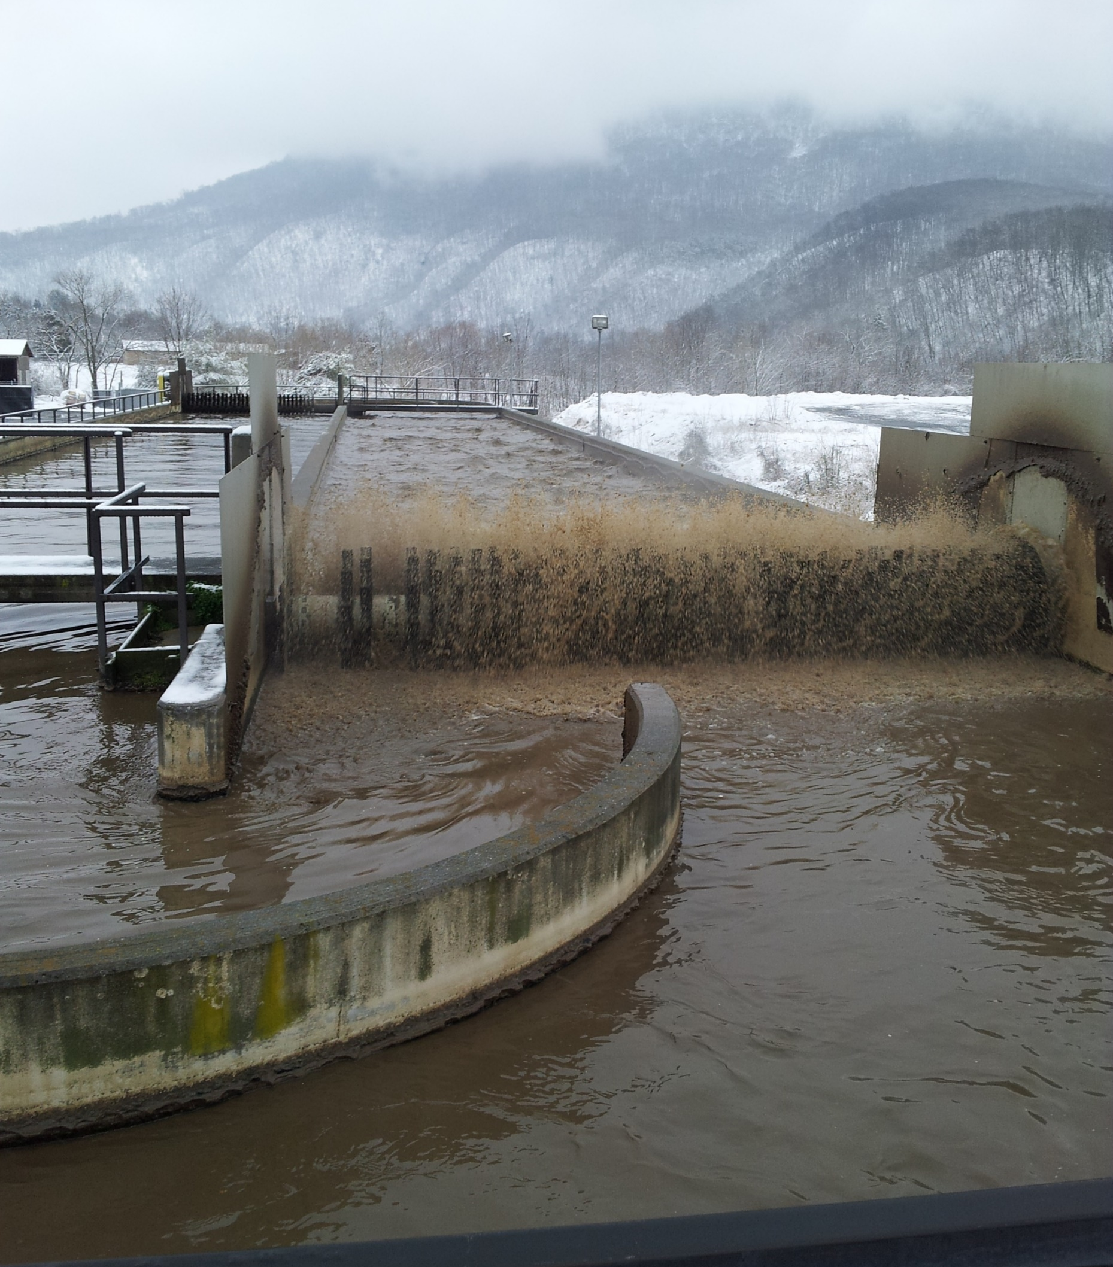
Oxidation Ditch

Slide 30
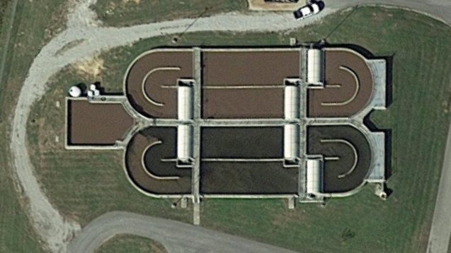

Slide 31
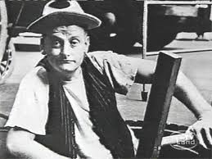
Comments & Questions
Grant Weaver
g.weaver@cleanwaterops.com

