Slide 1
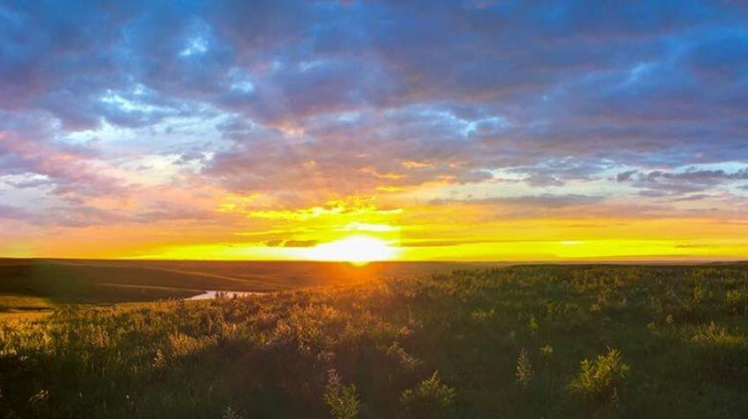
University of Kansas
100th Annual Water and Wastewater School
Lawrence, Kansas
July 30, 2019
Grant Weaver, PE & wastewater operator
G.Weaver@CleanWaterOps.com
Nitrogen Removal

Slide 2


Operational Strategies for Nutrient Removal
Nutrient Removal Overview
Nitrogen Removal
Science & Technology
Applying what we’ve learned
Phosphorus Removal
Science & Technology
Applying what we’ve learned
Aero-Mod Phosphorus and Nitrogen Removal

Slide 3


Slide 4
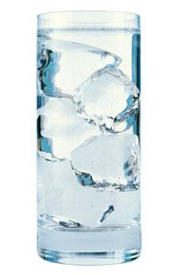
Wastewater Science
Alkalinity and pH

Slide 5
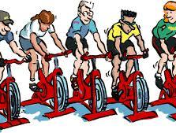
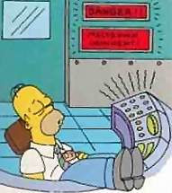
ORP (Oxygen Reduction Potential)
Wastewater Science
DO and ORP
DO (Dissolved Oxygen)

Slide 6
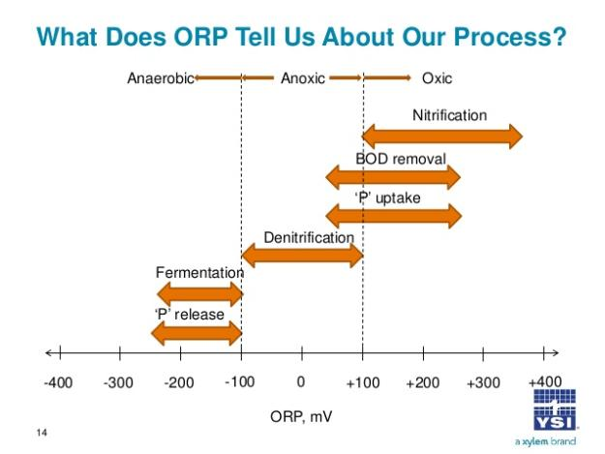

Slide 7

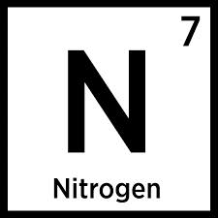

Slide 8

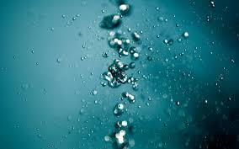
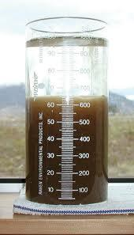
Biological Nitrogen Removal:
Convert LIQUID to GAS …
BOD and TSS Removal:
Convert LIQUID to SOLID …

Slide 9
Step 1: Convert Ammonia (NH₄) to Nitrate (NO₃)
          Oxygen-rich Aerobic Process
          Don’t need BOD for bacteria to grow
          Bacteria are sensitive to pH and temperature
Step 2: Convert Nitrate (NO₃) to Nitrogen Gas (N₂)
          Oxygen-poor Anoxic Process
          Do need BOD for bacteria to grow
          Bacteria are hardy

Slide 10
Ammonia Removal
Ammonia (NH₄) is converted to Nitrate (NO₃)
Ammonia (NH₄)

Slide 11
Ammonia Removal
Oxygen (O₂)
Ammonia (NH₄)

Slide 12
Ammonia Removal
Oxygen (O₂)
Ammonia (NH₄)
Alkalinity
H⁺

Slide 13
Ammonia Removal
Oxygen (O₂)
Ammonia (NH₄)
Nitrite (NO₂)
Alkalinity
H⁺

Slide 14
Ammonia Removal
Oxygen (O₂)
Oxygen (O₂)
Ammonia (NH₄)
Nitrite (NO₂)
Alkalinity
H⁺

Slide 15
Ammonia Removal
Oxygen (O₂)
Oxygen (O₂)
Ammonia (NH₄)
Nitrite (NO₂)
Nitrate (NO₃)
        Nitrification Habitat:
          High DO / +ORP
          Low BOD
          High MLSS/MCRT
          High HRT
          Consumes oxygen
          Consumes alkalinity: lowers pH
Alkalinity
H⁺

Slide 16
Nitrification:
Ammonia (NH₄) is converted to Nitrate (NO₃)
  Oxygen Rich Habitat
          MLSS* of 2500+ mg/L (High Sludge Age / MCRT / low F:M)
          ORP* of +100 to +150 mV (High DO)
          Time* (high HRT … 24 hr, 12 hr, 6 hr)
          Low BOD
          Consumes Oxygen
          Adds acid - Consumes 7 mg/L alkalinity per mg/L of NH₄ → NO₃
  *Approximate, each facility is different.

Slide 17
Biological Nitrogen Removal:
Next step:
the Nitrate (NO₃) created during Nitrification …
is converted to Nitrogen Gas (N₂)

Slide 18
Nitrate Removal
Nitrate (NO₃)

Slide 19
Nitrate Removal
BOD
Nitrate (NO₃)

Slide 20
Nitrate Removal
BOD
Nitrate (NO₃)
Nitrogen Gas (N₂)

Slide 21
Nitrate Removal
BOD
Oxygen
Nitrate (NO₃)
Nitrogen Gas (N₂)

Slide 22
Nitrate Removal
BOD
Oxygen
Nitrate (NO₃)
Nitrogen Gas (N₂)
Alkalinity
Denitrification Habitat:
  Low DO / -ORP
  High BOD
  Adds DO
  Gives back ½ the alkalinity: beneficially raises pH

Slide 23
Denitrification:
Nitrate (NO₃) is converted to Nitrogen Gas (N₂)
  Oxygen Poor Habitat
          ORP* of -100 mV or less (DO < 0.3 mg/L)
          Surplus BOD* (100-250 mg/L: 5-10 times as much as NO₃)
          Retention Time* of 45-90 minutes
          Gives back Oxygen
          Gives back Alkalinity (3.5 mg/L per mg/L of NO₃ → N₂)
    *Approximate, each facility is different.

Slide 24
 | 1. Nitrification | 2. Denitrification
 | Ammonia Removal | Nitrate Removal
 | NH₄→NO₃ | NO₃→N₂
DO: Dissolved Oxygen | >1 mg/L | <0.3 mg/L
ORP: Oxygen Reduction Potential | >+100 mV | <-100 mV
MLSS | >2500 mg/L | >2500 mg/L
HRT (Hydraulic Retention Time) | >6 hr | ~1 hr
BOD: Biochemical Oxygen Demand | <20 mg/L | >100 mg/L
Alkalinity | >60 mg/L | NA
 | Alkalinity is lost | Alkalinity is gained
Notes:
> means "greater than"
< means "less than"
~ means "approximately“ All numbers are “rules of thumb”
Nitrogen Removal

Slide 25
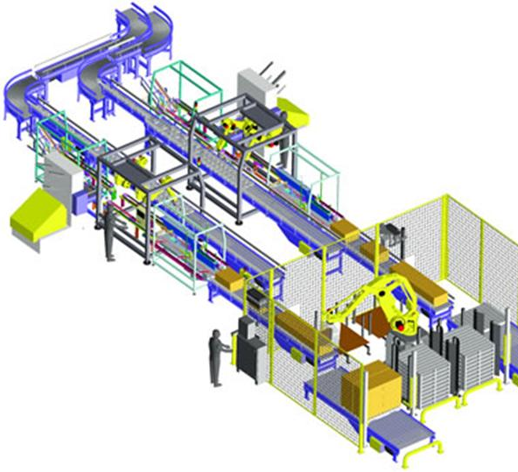
Technology!

Slide 26
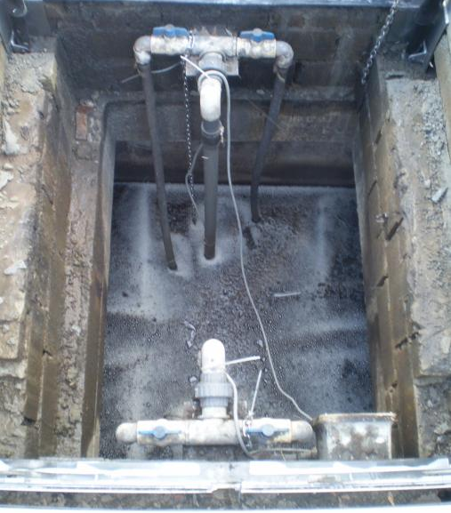
Post Denitrification

Slide 27
Post-Anoxic Denitrification
Aerobic Zone
Anoxic Zone
Secondary
Clarifier
BOD
NH₄
NO₃
NO₃
N₂
          Ammonia (NH₄) Removal
          Target: NH₄ < 0.5 mg/L
          Nitrate (NO₃) Removal
          Target NO₃ in Anoxic Tank: 0.5-2 mg/L

Slide 28
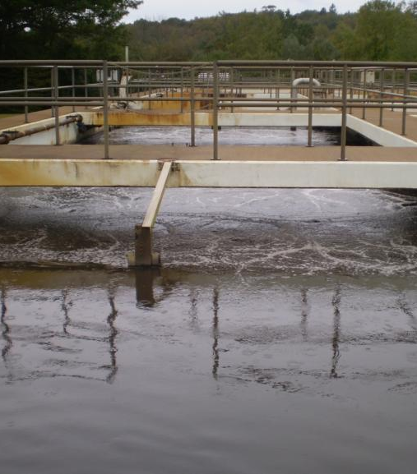
MLE Process
(Modified Ludzack-Ettinger)

Slide 29
MLE (Modified Ludzack-Ettinger) Process
Anoxic Zone
Aerobic Zone
Secondary
Clarifier
Internal Recycle
NH₄
NO₃
Return Sludge

Slide 30
MLE (Modified Ludzack-Ettinger) Process
Anoxic Zone
Aerobic Zone
Secondary
Clarifier
Internal Recycle
NO₃
NH₄
Return Sludge

Slide 31
MLE (Modified Ludzack-Ettinger) Process
Anoxic Zone
Aerobic Zone
Secondary
Clarifier
Internal Recycle
NO₃
N₂
NH₄
Return Sludge
          Ammonia (NH₄) Removal
          Target: NH₄: 0.5 mg/L
          Nitrate (NO₃) Removal
          Target NO₃ in Anoxic Tank: 2 mg/L

Slide 32
MLE (Modified Ludzack-Ettinger) Process
Anoxic Zone
Aerobic Zone
Secondary
Clarifier
Internal Recycle
NO₃
N₂
NH₄
NO₃
Return Sludge
MLE Process Control:
Proper Internal Recycle Rate; not too much / not too little.
ORP of +100 mV in Aerobic Zone for Ammonia (NH₄) Removal.
ORP of -75 to -150 mV in Anoxic Zone for Nitrate (NO₃) Removal.
Enough BOD to support Nitrate (NO₃) Removal.

Slide 33
MLE with not enough Internal Recycle
Anoxic Zone
Aerobic Zone
Secondary
Clarifier
Internal Recycle
NO₃
N₂
NH₄
NO₃
Return Sludge
          Ammonia (NH₄) Removal
          Excellent Aerobic Habitat: ORP +150 mV
          NH₄ < 0.5 mg/L
          Nitrate (NO₃) Removal
          Great Anoxic Habitat: ORP -150 mV or lower
          NO₃ > 4 mg/L because too little NO₃ is returned to Anoxic Zone

Slide 34
MLE with too much Internal Recycle
Anoxic Zone
Aerobic Zone
Secondary
Clarifier
Internal Recycle
NO₃
N₂
NH₄
NO₃
Return Sludge
          Ammonia (NH₄) Removal
          Good Aerobic Habitat: ORP +100 mV
          NH₄ < 0.5 mg/L
          Nitrate (NO₃) Removal
          Stressed Anoxic Habitat: ORP 0 to -100 mV
          NO₃ > 4 mg/L: bacteria will not convert Ammonia (NH₄) to Nitrate (NO₃)

Slide 35
MLE with way too much Internal Recycle
Anoxic Zone
Aerobic Zone
Secondary
Clarifier
Internal Recycle
NO₃
N₂
NH₄
NO₃
Return Sludge
          Ammonia (NH₄) Removal
          Poor Aerobic Habitat: ORP +50 mV
          NH₄ > 0.5 mg/L
          Nitrate (NO₃) Removal
          Poor Anoxic Habitat: ORP 0 mV or higher
          NO₃ > 4 mg/L

Slide 36
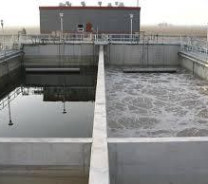
Sequencing Batch Reactor
SBR

Slide 37
Sequencing Batch Reactor (SBR)
Ammonia (NH₄) Removal: Nitrification
SBR #1
SBR #2
NH₄
NO₃
Air ON
Idle
          Ammonia (NH₄) Removal
          Target: NH₄ < 0.5 mg/L
Sludge Storage

Slide 38
Sequencing Batch Reactor (SBR)
Nitrate (NO₃) Removal: Denitrification
SBR #1
SBR #2
NO₃
N₂
Air OFF
Idle
          Nitrate (NO₃) Removal
          Target: NO₃ < 4 mg/L
Sludge Storage

Slide 39
Sequencing Batch Reactor (SBR)
Settle, Decant & Waste Sludge
SBR Process Control:
Establish cycle times that are long enough to provide optimal habitats.
And, short enough to allow all of the flow to be nitrified and denitrified.
SBR #1
SBR #2
Decant / Waste
Air ON
Sludge Storage

Slide 40
Optimizing SBR cycle time
  Too short
          Will not reach +100 mV for Ammonia (NH₄) Removal.
          Will not reach -100 mV for Nitrate (NO₃) Removal.
          Note: Temperature and BOD affect Air OFF cycle.
  Too long
          Wastewater will pass through tank before all Ammonia (NH₄) converted to Nitrate (NO₃).
          And, before all Nitrate (NO₃) is converted to Nitrogen Gas (N₂).
  Just right
          Good habitats …
          ORP of +100 mV for 60 minutes
          And, ORP of -100 mV for 30 minutes.
          Bonus: Changing conditions will serve as a selector.

Slide 41
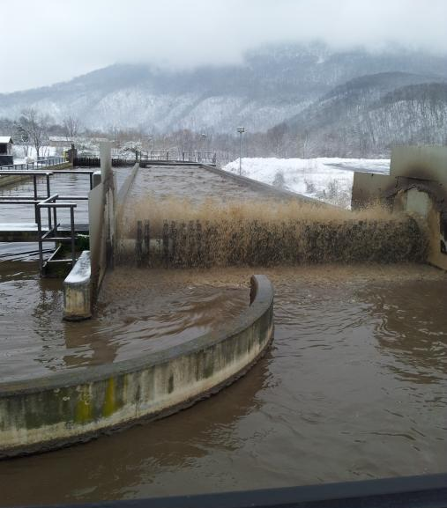
Oxidation Ditch

Slide 42
Oxidation Ditch
Anoxic Zone
Aerobic Zone
Anoxic Zone
Aerobic Zone
Secondary
Clarifier
NH₄

Slide 43
Oxidation Ditch
Anoxic Zone
Aerobic Zone
Anoxic Zone
Aerobic Zone
Secondary
Clarifier
NH₄
NO₃

Slide 44
Oxidation Ditch
Anoxic Zone
Aerobic Zone
Anoxic Zone
Aerobic Zone
Secondary
Clarifier
NO₃
N₂

Slide 45
Oxidation Ditch
Anoxic Zone
Aerobic Zone
Anoxic Zone
Aerobic Zone
Secondary
Clarifier
NH₄

Slide 46
Oxidation Ditch
Anoxic Zone
Aerobic Zone
Anoxic Zone
Aerobic Zone
Secondary
Clarifier
NH₄
NO₃

Slide 47
Oxidation Ditch
Anoxic Zone
Aerobic Zone
Anoxic Zone
Aerobic Zone
Secondary
Clarifier
NO₃

Slide 48
Oxidation Ditch
Anoxic Zone
Aerobic Zone
Anoxic Zone
Aerobic Zone
Secondary
Clarifier
NO₃
N₂

Slide 49
Oxidation Ditch
Anoxic Zone
Aerobic Zone
Anoxic Zone
Aerobic Zone
Secondary
Clarifier
          Ammonia (NH₄) Removal
          Target: NH₄ < 0.5 mg/L
          Nitrate (NO₃) Removal
          Target: NO₃ of 1-4 mg/L

Slide 50



Slide 51
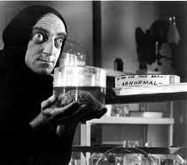
Experiment with YOUR plant:
Find the “Right” Process Control Strategy …
SBR
MLE
Oxidation ditch …
          and,
          Optimize Nitrogen Removal!

Slide 52
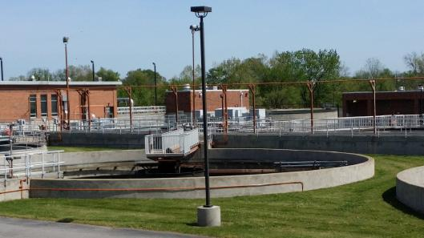

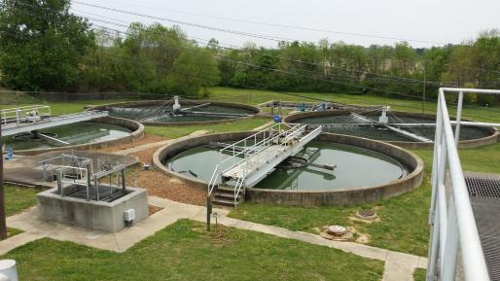
Change day-to-day operations to
create ideal habitats for bacteria to remove Nitrogen

Slide 53
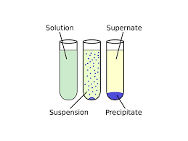
Biological Nitrogen Removal:
Convert LIQUID to GAS …
BOD and TSS Removal:
Convert LIQUID to SOLID …

Slide 54
 | 1. Nitrification | 2. Denitrification
 | Ammonia Removal | Nitrate Removal
 | NH₄→NO₃ | NO₃→N₂
DO: Dissolved Oxygen | >1 mg/L | <0.3 mg/L
ORP: Oxygen Reduction Potential | >+100 mV | <-100 mV
MLSS | >2500 mg/L | >2500 mg/L
HRT (Hydraulic Retention Time) | >6 hr | ~1 hr
BOD: Biochemical Oxygen Demand | <20 mg/L | >100 mg/L
Alkalinity | >60 mg/L | NA
 | Alkalinity is lost | Alkalinity is gained
Notes:
> means "greater than"
< means "less than"
~ means "approximately“ All numbers are “rules of thumb”
Nitrogen Removal

Slide 55


Slide 56

Optimize Ammonia (NH₄) Removal

Slide 57
Conventional Activated Sludge Plant
Primary Clarifier
Aeration Tank
Secondary Clarifier
NH₄
NO₃
          Ammonia (NH₄) Removal
          Target: less than 0.5 mg/L
          Raise mixed liquor
            … the higher the better for N-Removal.
          Keep ORP at +100 mV (or higher) by adjusting DO settings until …
            … enough DO & ORP to reduce NH₄ to 0.5 mg/L …
            … but not so much as to move too much DO into Anoxic or waste electricity.
            Warning: pH and Nitrite (NO₂)

Slide 58
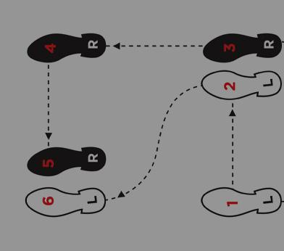
Step 2:
Optimize Nitrate (NO₃) Removal

Slide 59
Operate Aeration Tank as SBR

Slide 60
Conventional Activated Sludge operated as SBR
Primary Clarifier
Aeration Tank
Secondary Clarifier
NH₄
NO₃
          Maintain Ammonia (NH₄) Removal
          Target: NH₄ < 0.5 mg/L
          ORP: +100 mV long enough
          (60 minutes)

Slide 61
Conventional Activated Sludge operated as SBR
Primary Clarifier
Aeration Tank
Secondary Clarifier
NH₄
NO₃
          Maintain Ammonia (NH₄) Removal
          Target: NH₄ < 0.5 mg/L
          ORP: +100 mV long enough
          (60 minutes)
          Nitrate (NO₃) Removal
          Target: NO₃ < 4 mg/L
          ORP: -100 mV long enough (30 minutes)
          If habitats are good and NO₃ remains high, likely not enough BOD.
          Search for additional BOD.
NO₃
N₂
          Cycle air ON to remove NH₄ & OFF to remove NO₃
          Use ORP to adjust AirON/AirOFF times

Slide 62
Operate Aeration Tank as MLE

Slide 63
Primary Clarifier
Aeration Tank
Secondary Clarifier
N₂
NH₄
NO₃
NO₃
          Maintain Ammonia (NH₄) Removal
          Target: NH₄ < 0.5 mg/L
          ORP: +100 mV
          Nitrate (NO₃) Removal
          Target: NO₃ < 4 mg/L
          ORP: -100 mV
          Unless RAS can be increased to 200% or more, NO₃ target of 4 mg/L will be hard to achieve
Sludge Holding Tank
MLE Process Modification of Conventional Activated Sludge Plant

Slide 64
Primary Clarifier
Anoxic Tank
Aeration Tank
Secondary Clarifier
NO₃
N₂
NH₄
NO₃
          Maybe use Primary Clarifier as pre-Anoxic Tank
          Maybe install Internal Recycle Pump(s)
Sludge Holding Tank
MLE Process Modification of Conventional Activated Sludge Plant

Slide 65
Primary Clarifier
Aeration Tank
Secondary Clarifier
NH₄
NO₃
NO₃
N₂
          Maybe use Sludge Holding Tank or Gravity Thickener as post-Anoxic Tank
Sludge Holding Tank
Anoxic Tank
MLE Process Modification of Conventional Activated Sludge Plant

Slide 66
Primary Clarifier
Aeration Tank
Secondary Clarifier
NH₄
NO₃
          Or, modify operations to incorporate SBR and MLE Processes
NO₃
N₂
NO₃
N₂
Sludge Holding Tank
Anoxic Tank
MLE Process Modification of Conventional Activated Sludge Plant

Slide 67

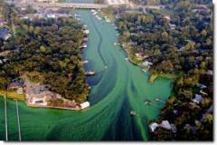

Slide 68
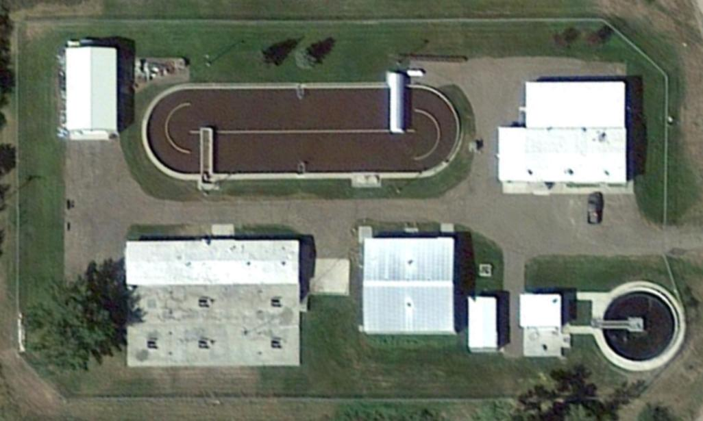
Chinook, Montana Population: 1,250 0.5 MGD design flow

Slide 69
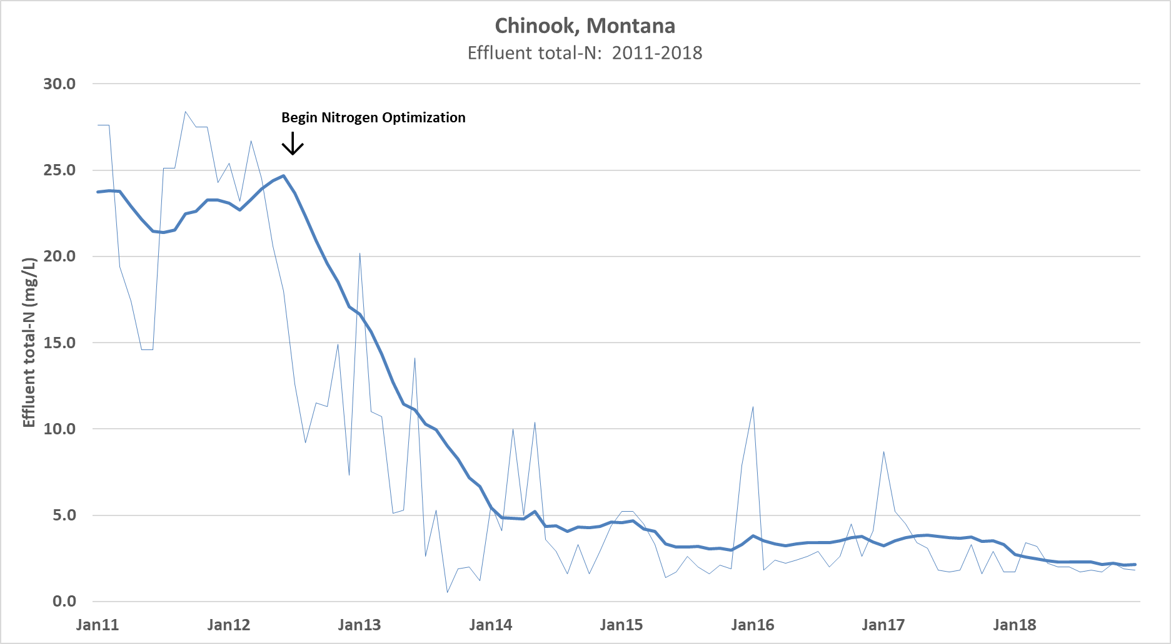

Slide 70
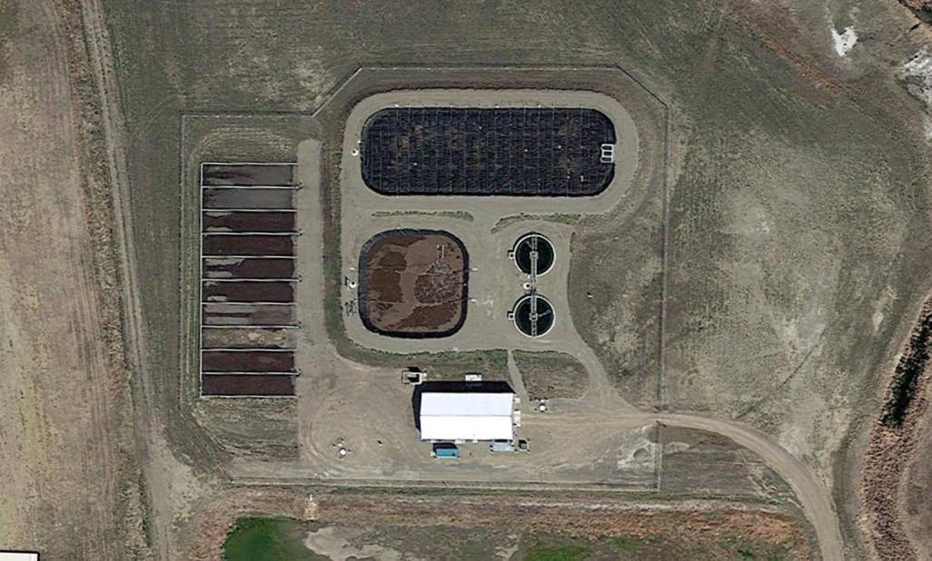
Conrad, Montana Population: 2,500 0.5 MGD design flow

Slide 71
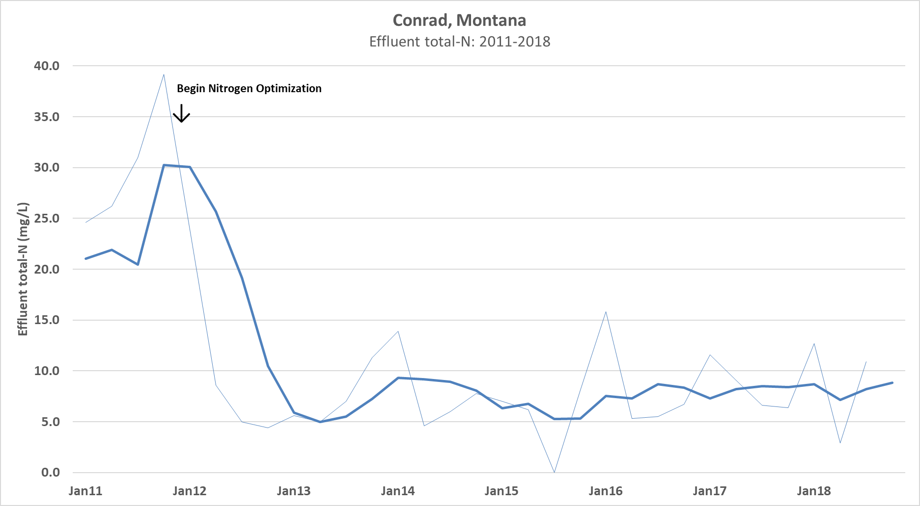

Slide 72
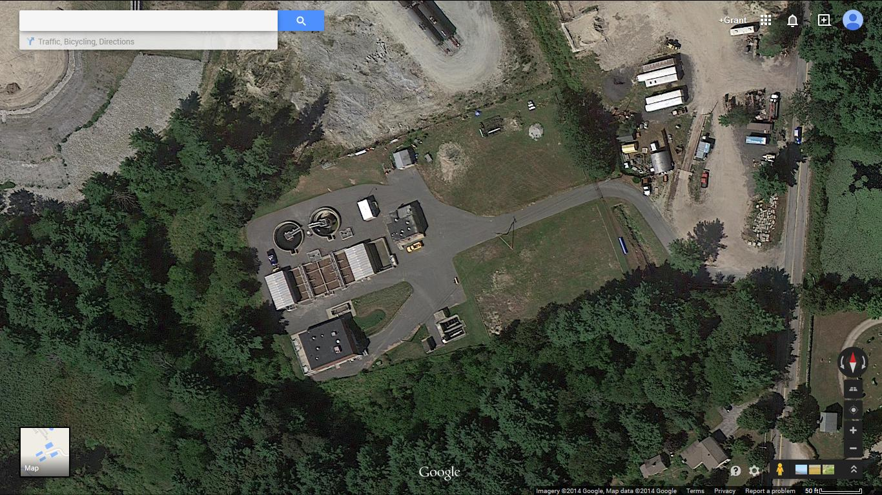
Upton, Massachusetts Population: 5,600 0.5 MGD design flow

Slide 73
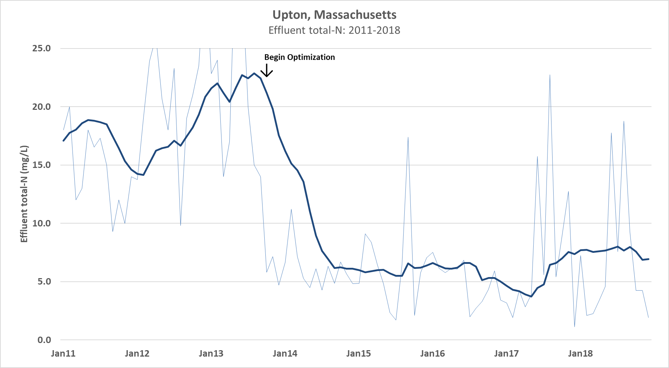

Slide 74
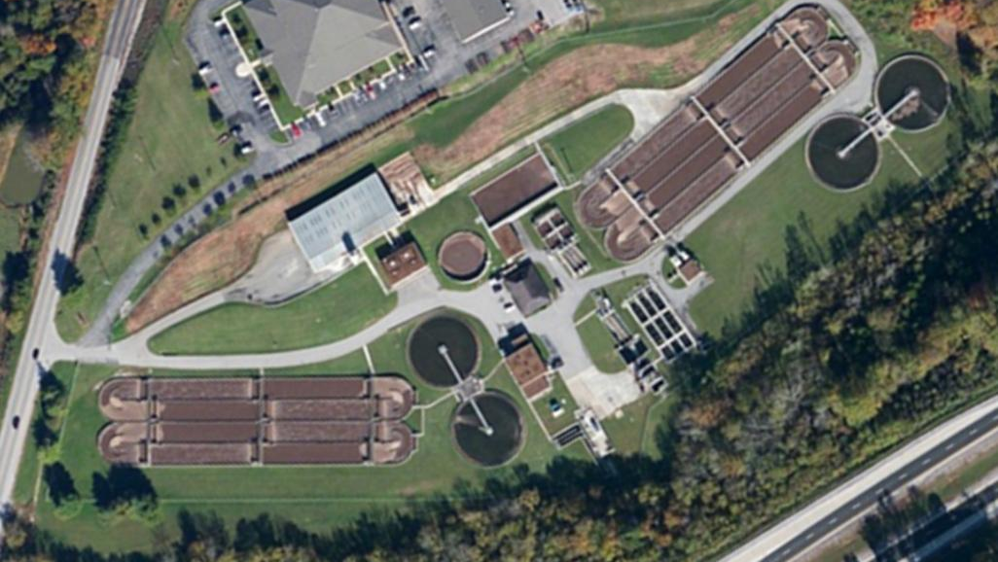
Cookeville, Tennessee Population: 33,500 15 MGD design flow

Slide 75
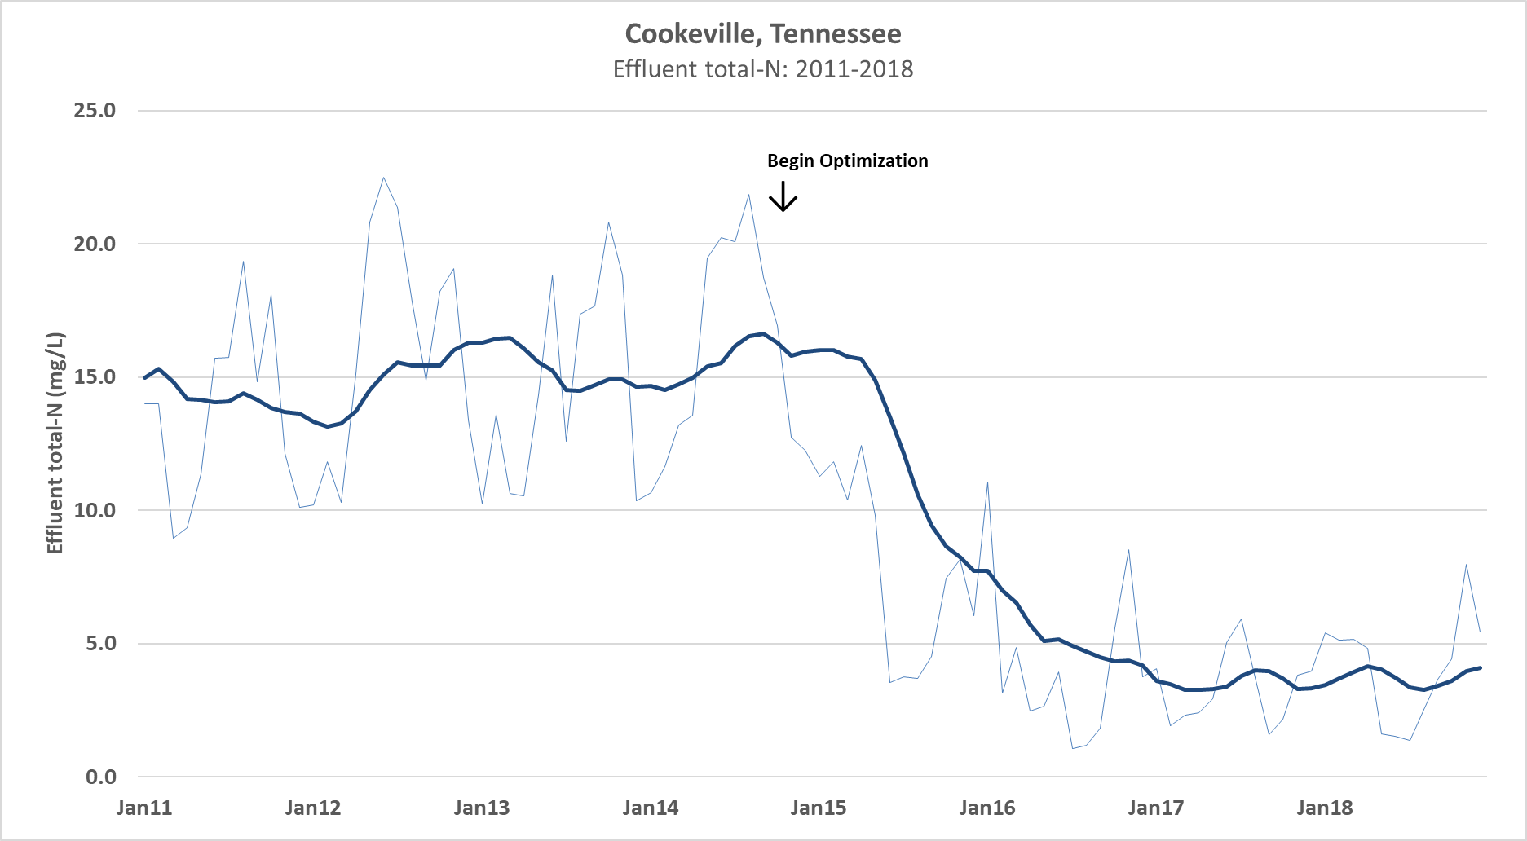

Slide 76
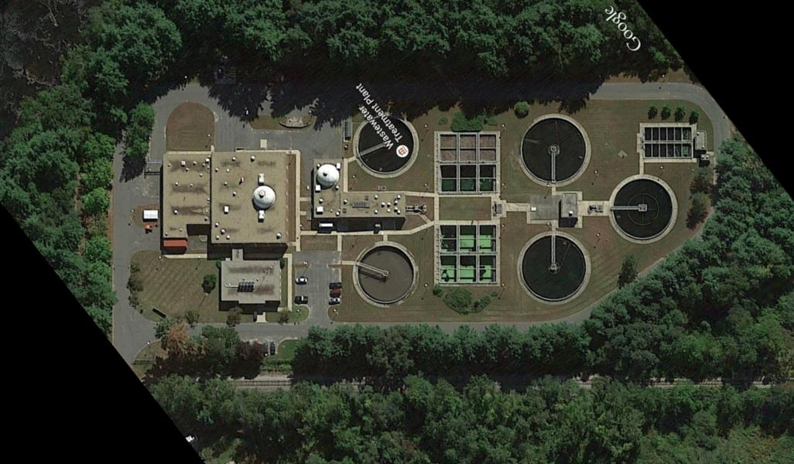
Palmer, Massachusetts Population: 12,200 5.6 MGD design

Slide 77
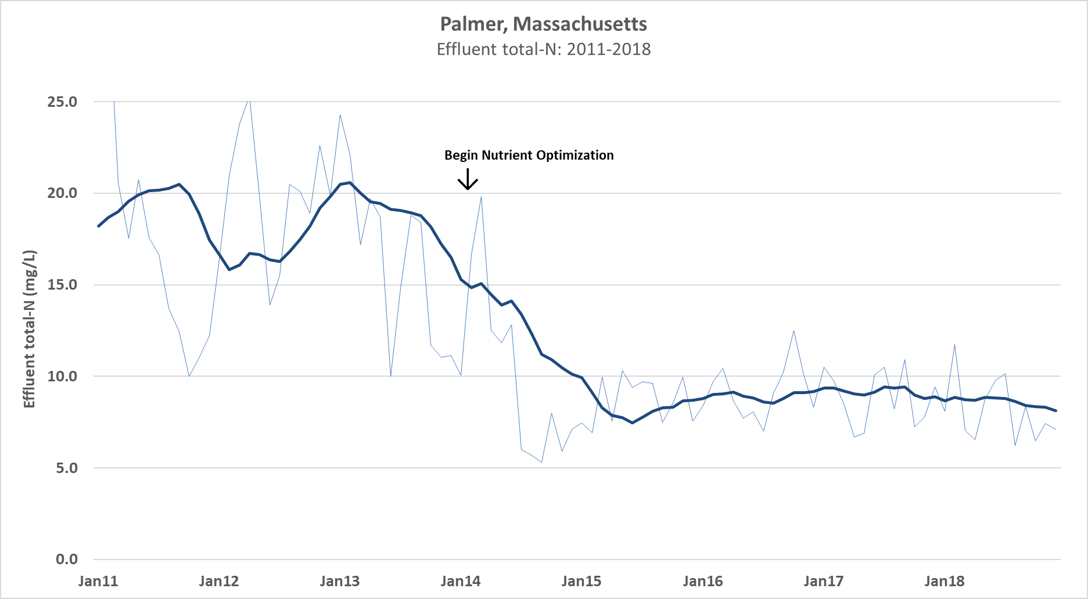

Slide 78
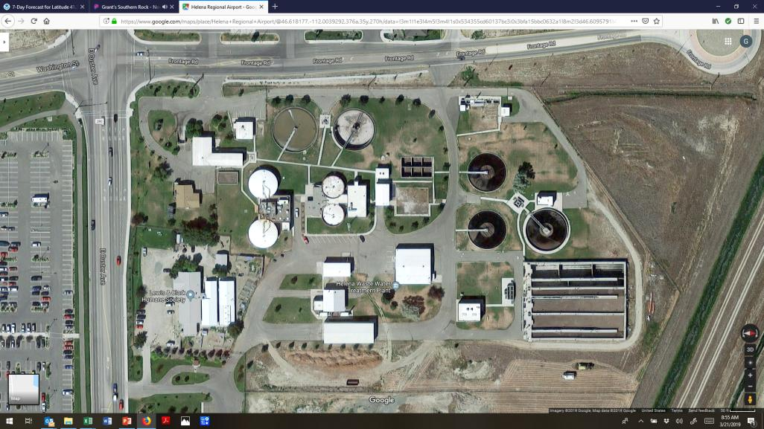
Helena, Montana Population: 31,500 5.4 MGD design flow

Slide 79
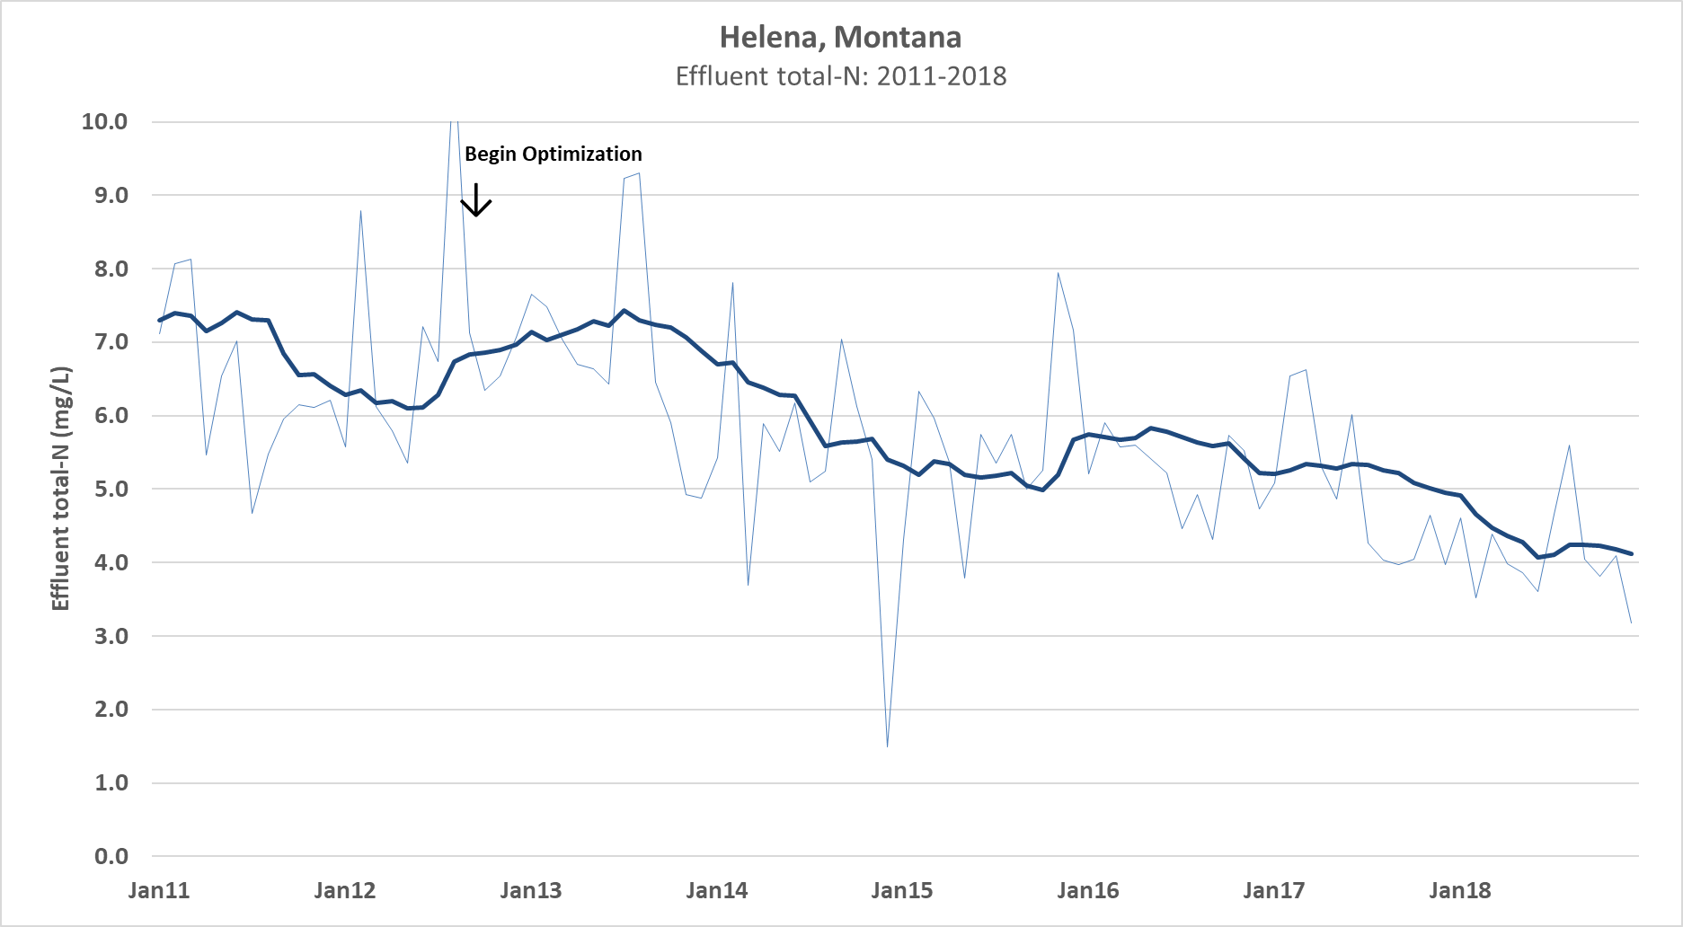

Slide 80
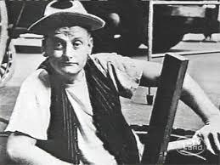
Comments & Questions
Grant Weaver
g.weaver@cleanwaterops.com

